Slide 1

Utah Housing
Data Analysis
Presenters
Zac Baxter
Ethan Bennett
Ryan Mosher
Stephen Singletary
Nathan Tyler
https://github.com/ReptilianRex6/Utah_Housing_Data.git

Slide 2


Our Objective:
Goal:
Evaluate Utah housing market and understand high prices.
Potentially forecast market trends.
Approach:
Collected data from correlated areas.
Analyzed factors influencing price increase.
Insights:
Identified contributing factors to price surge.
Future Outlook:
Examined implications for future market trends.

Slide 3




Project Overview
Time Series Analysis Of:
Median home prices
Average household income
Mortgage interest rates (30y fixed)
Utah population growth
Building permits
Final analysis

Slide 4

The Hypothesis: Supply and Demand
We believe that the average price of a home in Utah has risen significantly over time due to a combination of rising incomes, population growth, and changes in interest rates.

Slide 5
Data — The Fine Print
Data about median home prices in Utah, average Utah incomes over time, and Utah state house price indexes was accessed from FRED. Population in Utah over time was accessed from Neilsberg Research. FRED was used in large part because it was accessible and the quality of data was assured to be high. Neilsberg Research provided insights into Utah population for free after searching Google.
Data for median home price, income, population, and the house price index needed to be parsed into datetime format and merged into a single database. We chose to only focus on the data after 2000 in order to potentially capture both the 2008 recession and the 2020 Great Recession resultant from COVID-19 lockdowns.
Data analysis on the potential housing shortage in Utah began by isolating useful data and renaming columns in the DataFrame and making the assumption that every new unit built would satisfy housing demand for 3 people.
Data analysis for permits and population growth began by obtaining month over month figures by staggering monthly data, and obtaining percentage change and cumulative sums for permit amounts via built-in Numpy functions. Plotting both lines on a single graph was achieved via a built-in Matplot function after merging population and permit DataFrames.
Data analysis for correlations between income, home prices, and population required interpolation of data from annual data points into more granular monthly data points in order to more closely model changes over time and was achieved via a built-in Pandas function.

Slide 6

Data —
The Fine Print
- Data Sources
- Data Preparation
- Housing Shortage Analysis
- Permits and Population Growth
- Correlation Analysis

Slide 7
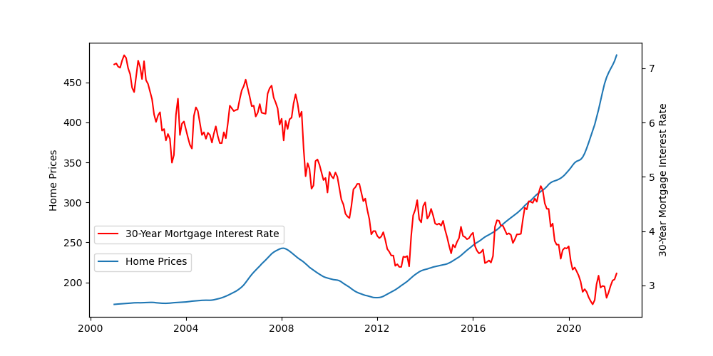
Interest Comparison/Correlation
Consider:
As rates over time declined, house prices increased.

Slide 8
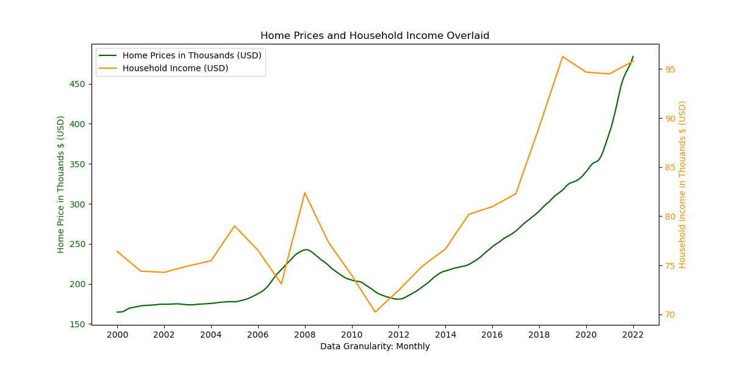
Income Comparison/Correlation
Consider:
Home prices tend to move with income
Increase in prices tend to lag increase in income

Slide 9
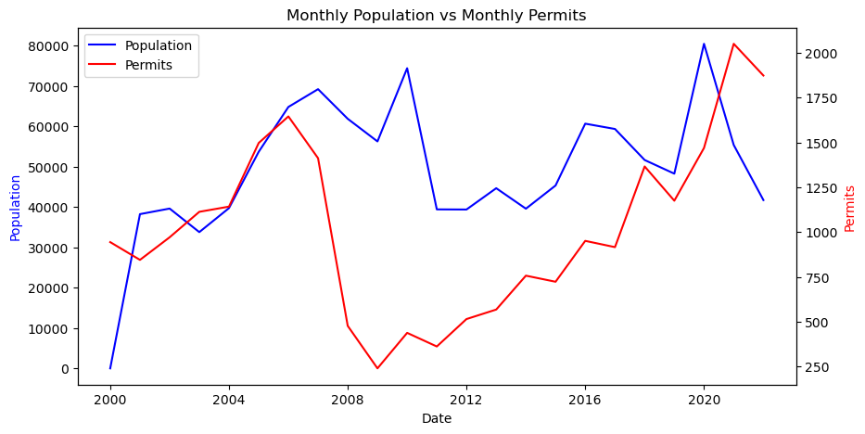
Building Permits vs. Population Growth
Consider:
Despite a sharp decrease in building permits, there was still a flow in 2010 of people moving into Utah. However, we can see in around 2011 the population growth did decline sharply. We suspect that this is due to a lag in economic situations, people staying put, and the difficulty of selling a home and uprooting.

Slide 10
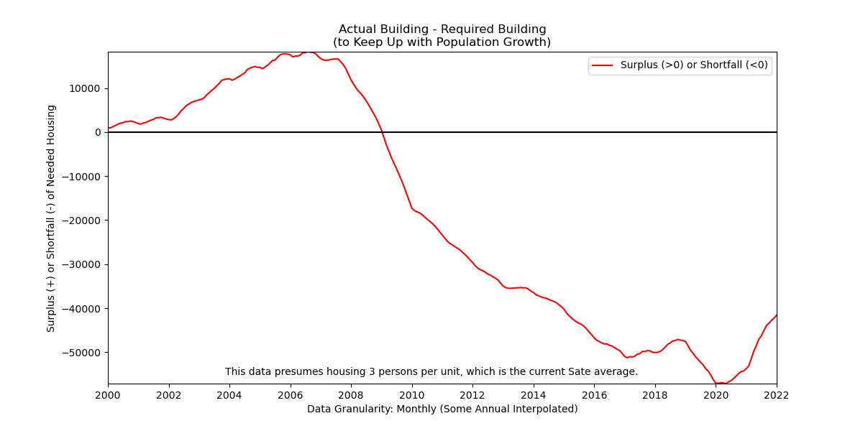
Building Permits vs. Population Growth
Not Building Enough Houses
Consider:
House building has not kept up with population growth since 2008.
Low supply with high demand causes high prices.

Slide 11
Raw Correlation Table
 | Home Prices
Income | 0.914838 | Income
Interest Rates | -0.629452 | -0.537467 | Interest Rates
Monthly Population Growth | 0.325746 | 0.336524 | -0.086505 | Monthly Population Growth
Building Permits | 0.856864 | 0.778959 | -0.865635 | 0.354026

Slide 12
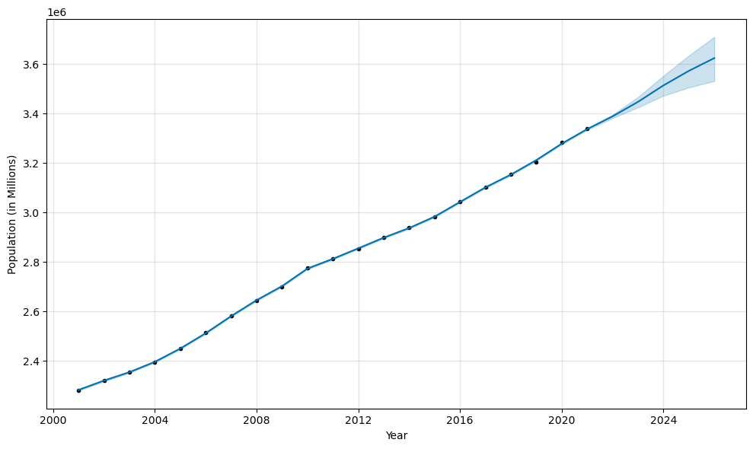
A Look Into the Future!
Our “prophecy” for the population of Utah predicted that in 2022 the population would be 3,389,568.
A difference of .2%!
The actual population measured in 2022 was 3,380,800.
Our model predicts that the population in 2026 will be 3.63 Million!
Notes:
We wanted to take another preliminary dive into the world of forecasting using our Prophet modeling. *Click*
We wanted to use known values from the same dataset to ‘check’ it’s accuracy. *Click*
We were very excited about the power of the tool when it was first tried on the our population dataframe. The forecast was very close. *Click*
And everyone can ‘take it to the bank that our model will successfully predict the correct population for Jan 2026 ;)*Click*
*Next Slide*

Slide 13
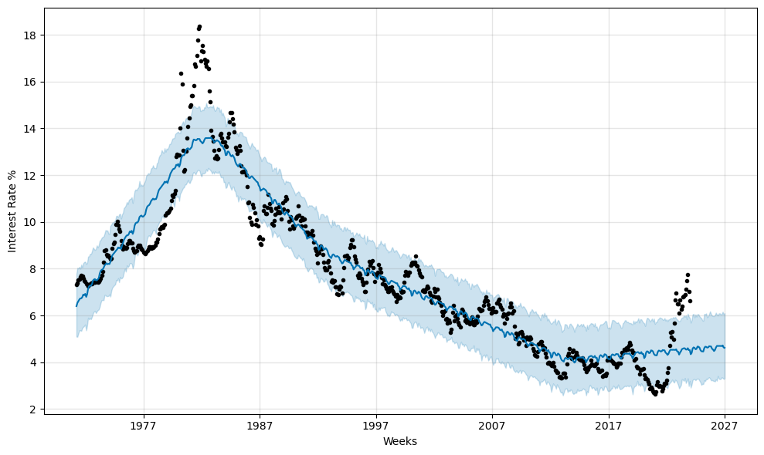
“False Prophets”
Calculated Mean Average Error was ~1.29%
Our “prophecy” for Mortgage Rates predicted a rate of 4.33% in Feb 2024
Actual Interest Rates are 6.63%
Notes:
However, as we tried it with other datasets we found there was quite a mixed bag of performance between the known outcomes and the projected outcomes from our model. *click*
Unfortunately, our model missed badly with the interest rates. *click*
Upon exploring methods or formulas for evaluating the performance of the model, I applied the Mean Average Error to the model with mortgage rates, this value indicated that the average discrepancy throughout the model was ~1.29% *click*
After interacting with our datasets for the past two weeks we noticed areas where we may have compromised some of the data. Interpolations and not accounting for a variety of external factors obviously had a varying impact on the different datasets.
Ethan is here to more comprehensively discuss other data sources and elements to consider in this exploration.

Slide 14

Other Factors to Study
Inflation
Cultural influences
Families staying in the state
Prices of building supplies
Job markets
Land availability
Housing density
Investors/Short Rentals

Slide 15

Final Analysis
Generally income is strongly correlates with home prices
Recent changes in interest rates have had a noticeable impact
Utah’s population keeps growing
Homes are not being built fast enough to keep up
Any Questions?

